Slide 1

Introduction to Cassandra
Sarthak Nagpal

Slide 2
Contents
Introduction
CAP Theorem
Cassandra Architecture
How data is read in Cassandra
How data is written in Cassandra
Use cases
Demo

Slide 3
Introduction
Fast largely distributed wide column NoSQL Database
High Availability
Massive Scalability(Horizontal)
High Performance
No single point of failure
Peer to peer architecture (Ring Type architecture)
Automatic data distribution and replication across all nodes
Supports multiple data centers

Slide 4
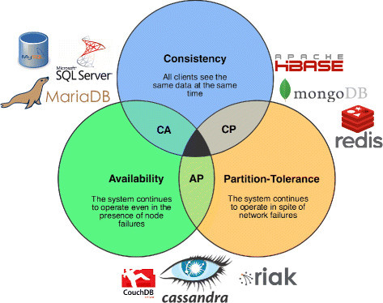
CAP Theorem
Consistency : Same data must be available in all nodes in the cluster at the same time.
Availability : Every request must get a response whether it succeeds or fails.
Partition Tolerance : The system continue to function and serve requests even if some part of the system fails.

Slide 5
Cassandra Architecture
Cassandra is not a column-oriented database but a partitioned row-store i.e a row has its own columns.
YourTable" : {
row1 : [{ "ID":1, "firstname":"fname1", "lastname":"lname1", "websitename":"site1", "timestamp":1582988571},{},{}]
row2 : { "ID":2, "firstname":"fname2", "lastname":"lname2", "websitename":"site2", "timestamp":1582989563}
row3 : { "ID":3, "firstname":"fname3", "lastname":"lname3", "websitename":"site3", "timestamp":1582989572}
}
The columns for every row can be variable which signifies ‘wide-column’ or column family design.
Any row has a partition key and a clustering key.
To search any row, partition key and clustering key needs to be specified in the query.

Slide 6
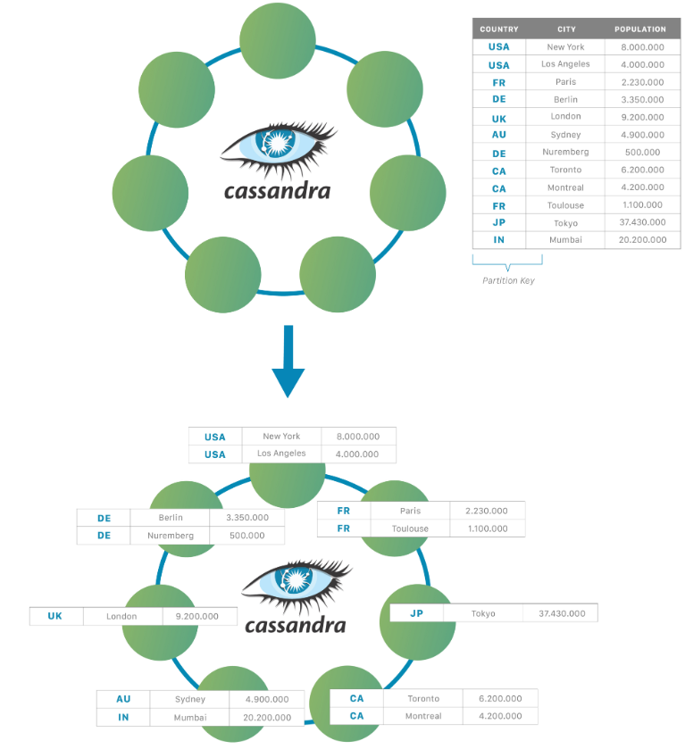
Every partition key is hashed (tokens) and data is stored on a specific node.
Data for a partition key will be stored in a particular node depending upon the hash value.
Data in one node is also replicated to other nodes depending upon the replication factor specified when creating keyspaces.

Slide 7
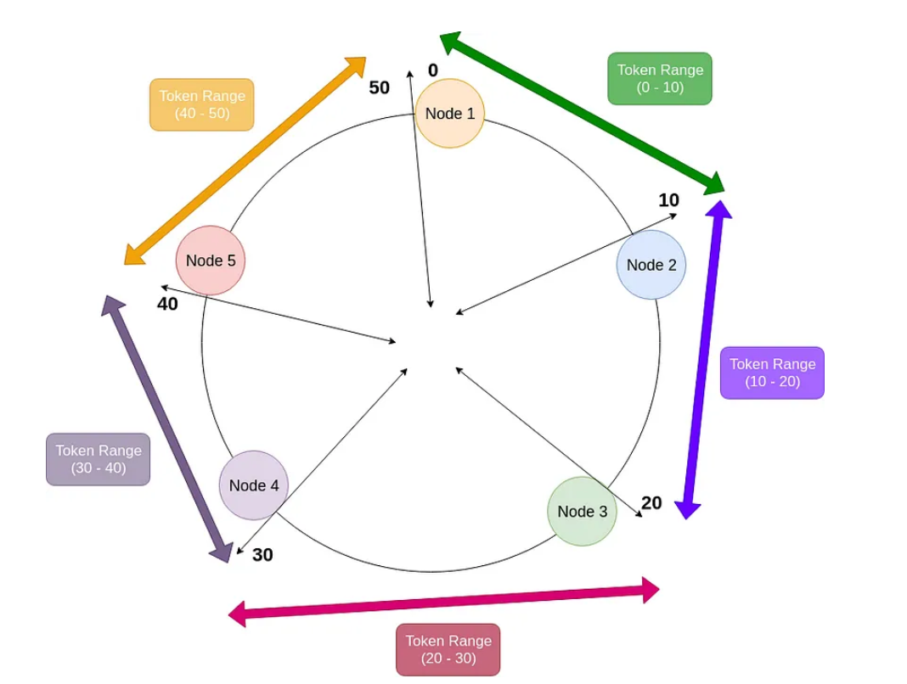
Data under a partition key is sorted by the clustering key provided as part of primary key.
PK = partition key + clustering key

Slide 8
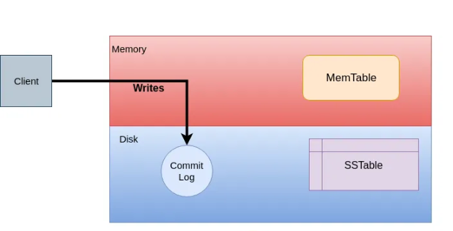
Data write in Cassandra
Any data will be written to commit log
Data from commit log will be written to memtable and write request will be acknowledged.
After reaching a configurable limit, data is flushed from memtable to immutable SSTables.
In time, multiple SSTables will be created with different versions of data.
These SSTables will be merged and outdated ones will be removed on basis of latest timestamp which is called Compaction.

Slide 9
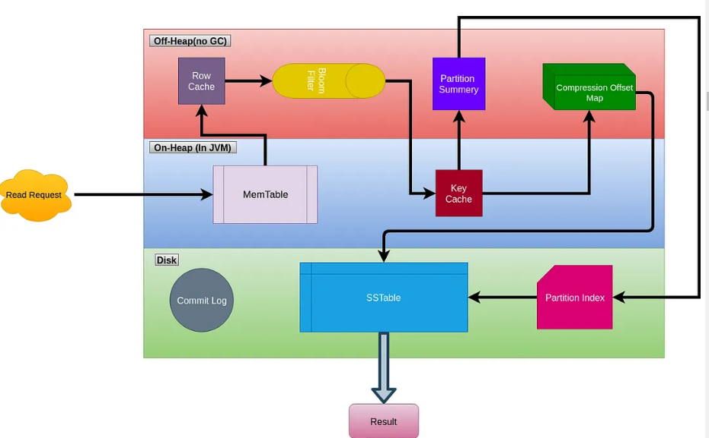
Data read in Cassandra

Slide 10
Use cases
Messaging apps
E-commerce and inventory management
Social Media Analytics and Recommendation Engine
IOT and Edge Computing
Fraud detection
Companies using Cassandra :
Netflix – audit logging
Soundcloud – organizing songs and playlists
Instagram – data replication
Others – Activision,Apple,etc.

Slide 11
References
https://www.datastax.com/blog/exploring-common-apache-cassandra-use-cases
https://cassandra.apache.org/_/cassandra-basics.html
https://cassandra.apache.org/_/case-studies.html
https://deloittedevelopment.udemy.com/course/from-0-to-1-the-cassandra-distributed-database/

Slide 12
Time for some demo :P
Thank You ☺

